Slide 1
Pictures for
“Stability and change in biological communities”
https://serendipstudio.org/exchange/bioactivities/succession

Slide 2
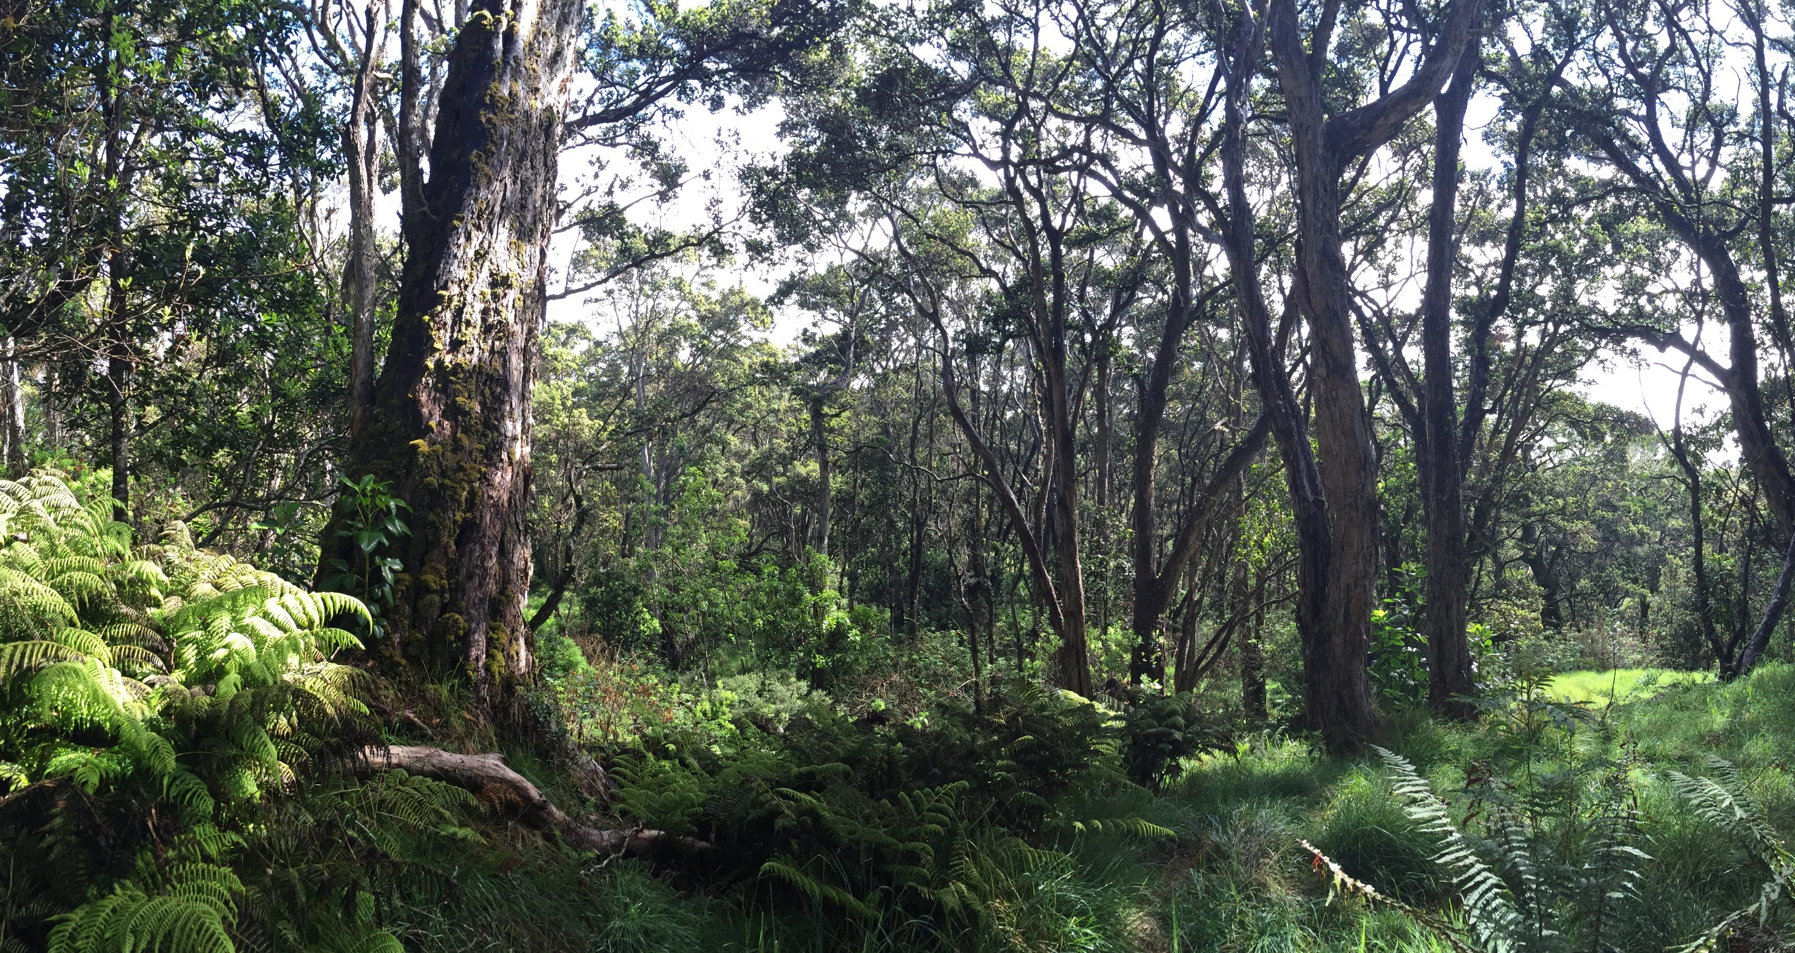
Hawaiian Tropical Forest

Slide 3
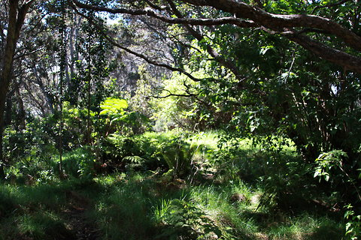
Hawaiian Tropical Forest

Slide 4
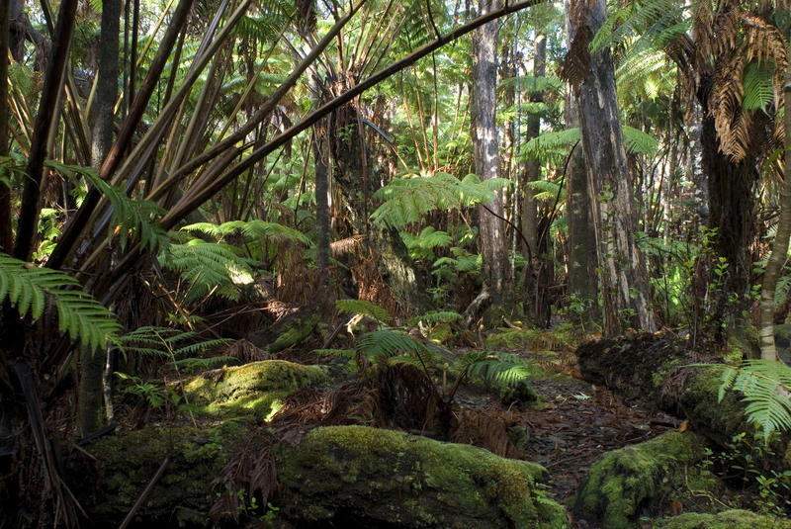
Hawaiian Tropical Forest, with moss

Slide 5
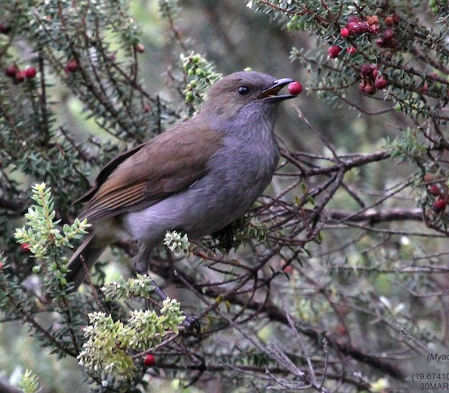
A Hawaiian bird eating fruit in a forest bush

Slide 6
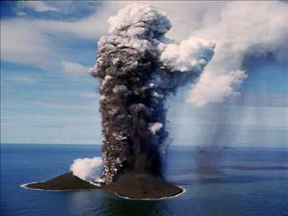
Formation of Surtsey Island

Slide 7
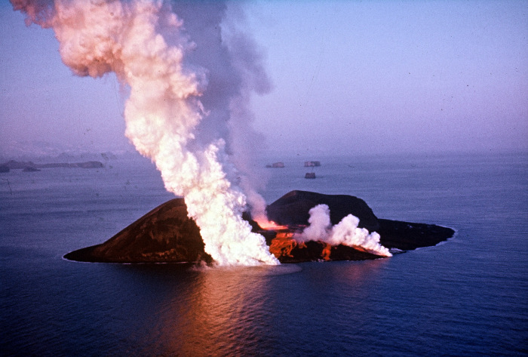
Formation of Surtsey Island

Slide 8
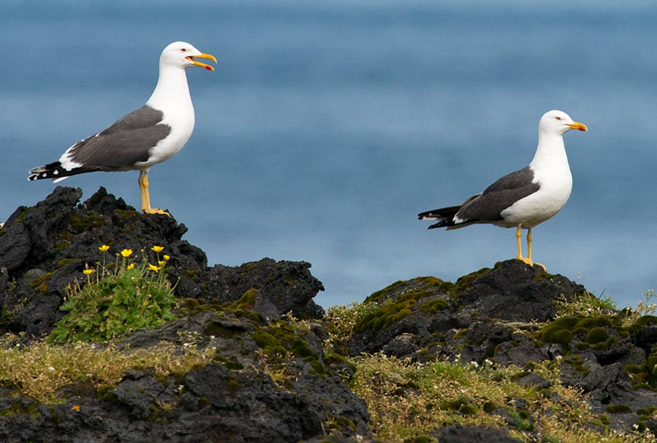
Surtsey Island

Slide 9
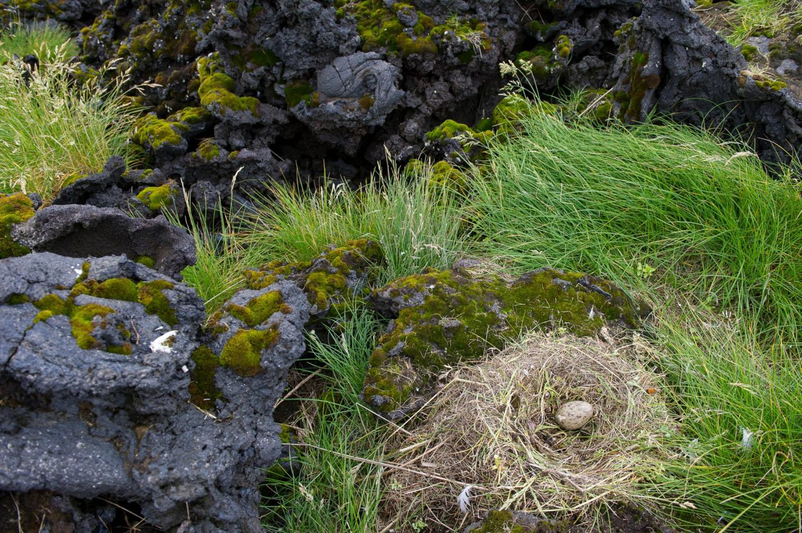

Slide 10
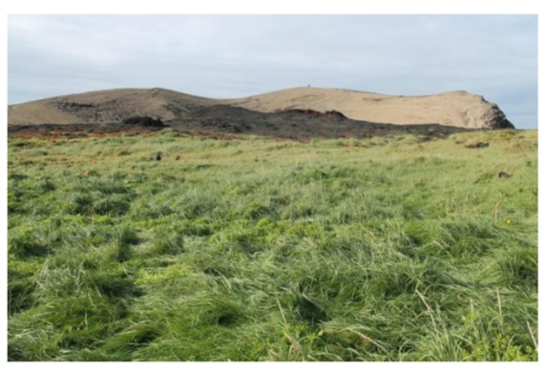
Grassland in Gull Colony on Surtsey Island

Slide 11
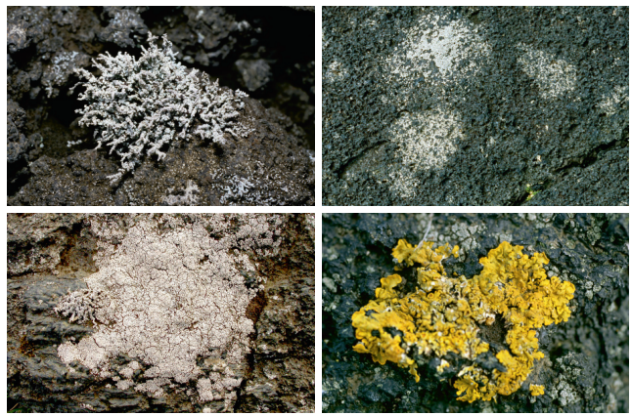
Lichen on Volcanic Rock

Slide 12
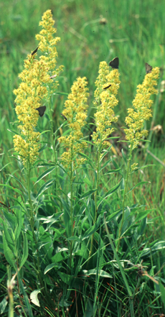
Farm field in eastern US abandoned for 1-5 years
Grasses, wildflowers and weeds with a few shrub and tree seedlings

Slide 13
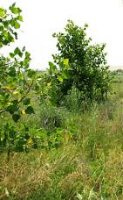
Farm field in eastern US abandoned for 10-15 years
Grasses, wildflowers and weeds with some shrubs and young trees

Slide 14
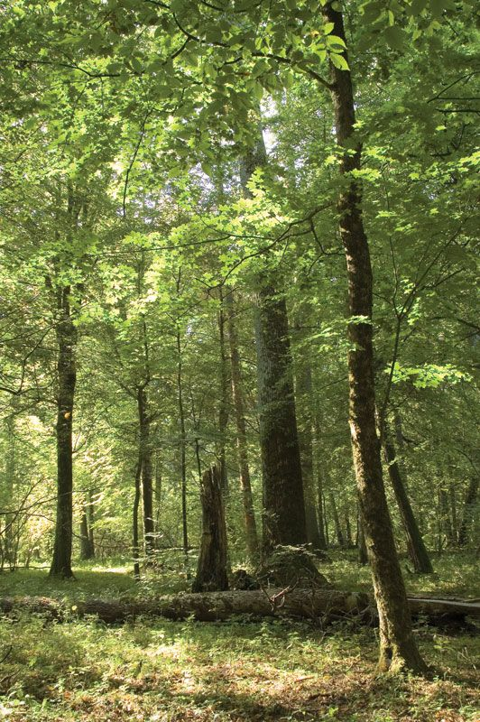
Farm field in eastern US abandoned for >20 years
Forest

Slide 15
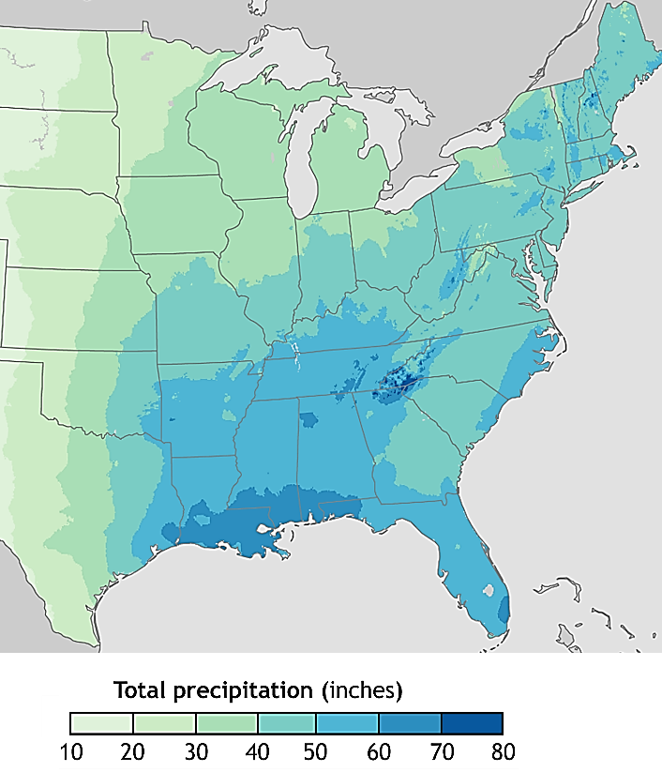
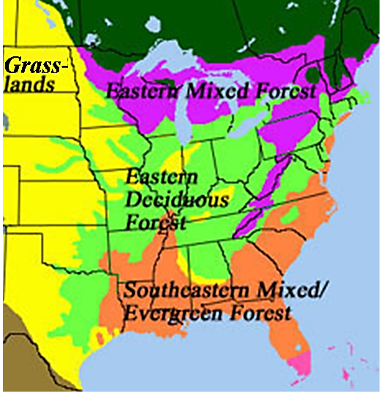
Precipitation vs. Biomes

Slide 16
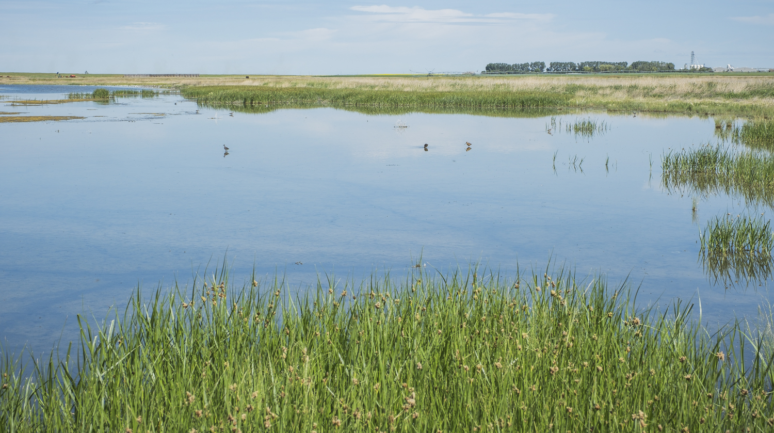
Pond with Marsh on Edges

Slide 17
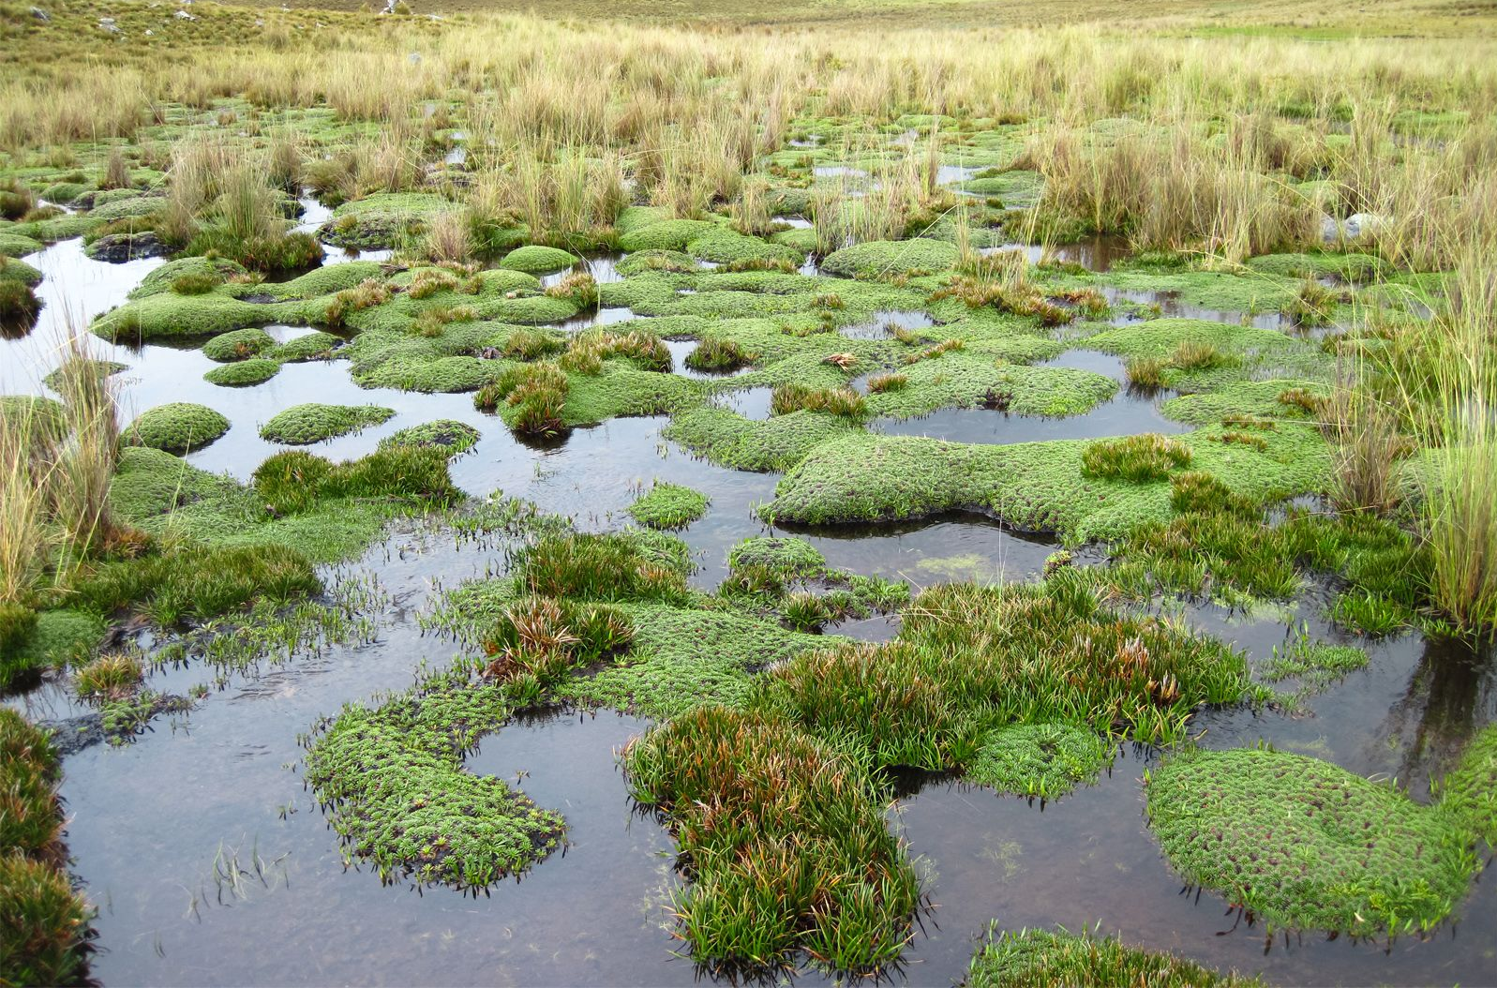
Bog

Slide 18
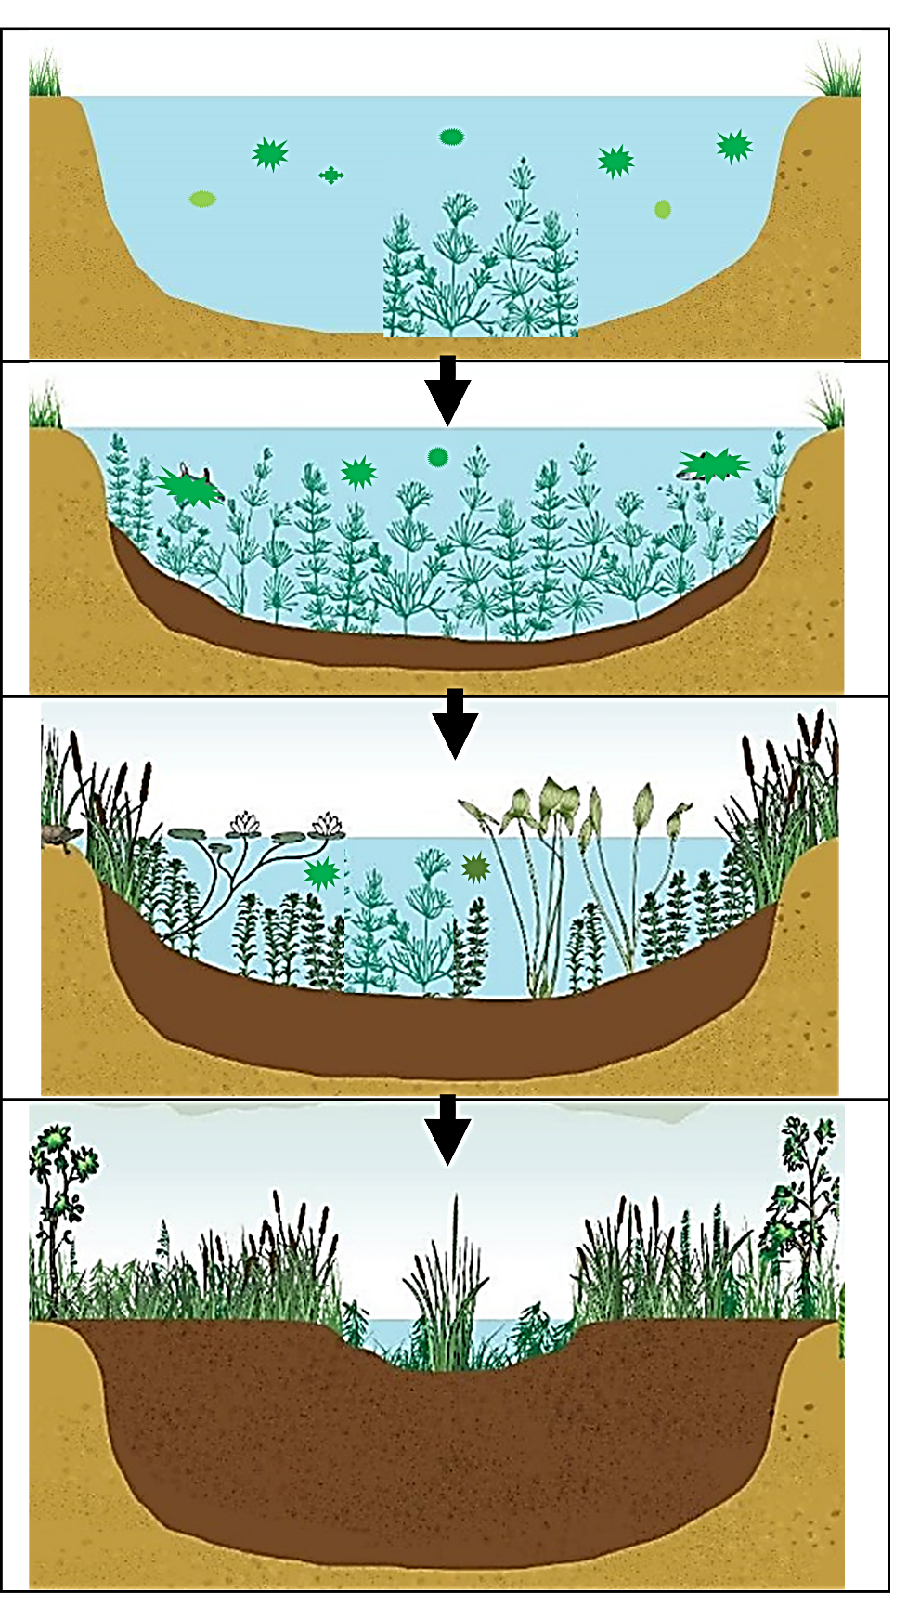
Succession in a Pond

